Slide 1
Frequency Reallocation Background
In June 2010, the President signed a Memorandum calling for the National Telecommunications and Information Administration (NTIA), in collaboration with the Federal Communications Commission (FCC), to make 500 megahertz of spectrum available for fixed and mobile wireless broadband in the next ten years.
The National Telecommunications and Information Administration (NTIA) in collaboration with the Federal Communications Commission (FCC), released a Ten-Year Plan and Timetable to make 500 megahertz of Federal and non-Federal spectrum available for wireless broadband use.

Slide 2
Background (continued)
In a Fast Track Evaluation, NTIA identified the following candidate frequency bands: 1675-1710 MHz, 3500-3650 MHz, 4200-4220 MHz, 4380-4400 MHz, and 1755-1780 MHz. These bands were selected based on factors such as the number of assignments within the band, type of operations, function, and location that might make possible the reallocation of the spectrum to accommodate wireless broadband systems without relocating Federal operations.
The Commerce Spectrum Management Advisory Committee (“CSMAC”) Working Group 1 (“WG-1”) was tasked with developing recommendations for use of the 1695-1710 MHz band for commercial services while protecting Federal meteorological earth stations from harmful interference.

Slide 3
Fast Track Eval Results
The results of the Fast Track Evaluation were that NTIA recommended that the 1695-1710 MHz and 3550-3650 MHz bands can be made available for wireless broadband, with some geographic limitations on wireless broadband implementation for a total of 115 MHz of the 500 requested.
NTIA also recommended, with respect to the 4200-4220 MHz and 4380-4400 MHz bands, that the Federal Government begin working within domestic and international processes to consider the reallocation of this spectrum for wireless broadband.
NTIA could not reach, in the timeframe allowed for the Fast Track Evaluation, a conclusion as to whether the 1755-1780 MHz band could be made available for wireless broadband within five years. This band would require the relocation of significant Federal operations before it could be reallocated for wireless broadband use.

Slide 4
FTE Results 2
Having considered options to reallocate the entire 1675-1710 MHz band or to reallocate a portion, NTIA concluded that the range 1695-1710 MHz offered opportunity for wireless broadband while minimizing overall disruption of operations upon which the domestic and international public safety and weather prediction communities depend. Emergency managers and the public currently rely on information which is broadcast from the National Oceanographic and Atmospheric Administration (NOAA) satellites in the 1690-1695 MHz band. NTIA concluded not to recommend the spectrum below 1695 MHz for sharing as part of the fast track process.
NTIA examined the possibility of making all or a portion of the 1675-1710 MHz band available without moving meteorological-satellites or radiosondes from this band, since neither the removal of the satellites or radiosondes could be accomplished within the five year timeframe established to make spectrum available for wireless broadband.

Slide 5
FTE Results 3
Recognizing that this band has an international allocation for meteorological-satellite downlinks for weather data and other countries support satellite downlinks in the band including to U.S. stations, any decision to relocate satellite transmissions would involve creating a World Radiocommunication Conferences (WRC) future agenda item for the 2016 conference with implementation some time later if the international community supports allocation changes. This would also involve identifying other bands for the satellite transmissions.
Regardless of any such decision the existing meteorological-satellites utilizing this band would continue to operate for many years.
In summary, NTIA examined the possibility that Federal Government operations would not be moved from this spectrum to make spectrum available for wireless broadband. Instead, major receive sites would be protected via geographic exclusion zones regulated through licensed wireless service areas.

Slide 6
CSMAC WG-1
In a January 2013 report, NTIA updated its analyses based on the updated LTE technical parameters as well as input from WG-1 on the propagation model and analysis approach, which resulted in a significant reduction in the anticipated separation distance at which an LTE system would potentially cause harmful interference to a Meteorological Satellite receiver as compared to the exclusion zone separation distances presented in NTIA’s Fast Track report. The impact on separation distances varies from site to site based on the assumptions and conditions used in the analysis, and ranges from 21-89%.
Working Group developed a framework for sharing the band that protects incumbent federal operations while maximizing the opportunity for commercial use. The framework recognizes the need to protect the operations of both the co-channel polar orbiting satellites as well as geostationary operations in the adjacent 1675-1695 MHz band.

Slide 7
Protection Zones
The framework is conditioned on Protection Zones that will be based on the NTIA interference analysis and protection criteria, including aggregate Interference Power Spectral Density (IPSD) limits, to be determined for each receiver location. The framework provides for deployment of commercial operations outside of the Protection Zones without any coordination. It also permits commercial operations within the Protection zone following a successful coordination process concluding that such commercial operations can meet specified conditions and will not cause harmful interference to ensure no loss of federal capability within the protection zones. If coordination is unsuccessful, commercial operations will not be permitted within the Protection Zone.

Slide 8
DCPR Changes for GOES-R
On the GOES-N/O/P satellites the DCPR downlink band is 1694.3 – 1694.7 MHz
  The uplink Pilot at 407.85 MHz is translated to 1694.45 MHz in the existing downlink
For the GOES-R series satellites the DCPR downlink band will be 1679.7 – 1680.1 MHz
  The uplink Pilot at 407.85 MHz will be translated to 1679.85 MHz in the new downlink
No uplink frequencies will change from the GOES-N to GOES-R satellites – only the downlinks

Slide 9
GOES R Frequency Plan
DOWNLINKS
(RAW DATA DOWNLINK NOT SHOWN)
(OQPSK, Linear Pol (N-S or E-W), 8220 MHz, BW=120 MHz)
Housekeeping
Telemetry
BPSK/RHC
1693.0 MHz
BW=80 kHz
DCPC
QPSK/DSSS
RHC
468.775 MHz
468.825 MHz
BW=95 kHz
DCPR
8PSK/FDM
Linear Pol
1679.7 to
1680.4 MHz
BW=0.7 MHz
GRB
Dual CP
1686.6 MHz
8PSK
BW=9.8 MHz
or QPSK
BW=10.9 MHz
ORTT&C
Telem & Rng
BPSK/PM
RHC Pol
2211.04 MHz
BW=4.93 MHz
HRIT/EMWIN
BPSK/Lin Pol
1694.1 MHz
BW=1.205 MHz
SAR
Bi-Φ/FDM/RHC
1544.550 MHz
BW=90 kHz
Radiosondes
1675 to
1679.6 MHz
1695 to 1710 MHz
is proposed for
internet mobile radio
470
1545
1670
1675
1680
1685
1690
1695
1700
2210
UPLINKS
DCPC
QPSK/DSSS
RHC Pol
2032.775 MHz
2032.825 MHz
BW=95 kHz
Command
BPSK/RHC
2034.2 MHz
BW=128 kHz
GRB
Dual Lin Pol
7216.6MHz
8PSK
BW=9.8 MHz
or QPSK
BW=10.9 MHz
DCPR
8PSK/FDM^{(†)}
RHC Pol
401.7 MHz to
402.4 MHz
BW=0.7 MHz
SAR
Bi-Φ/FDM^{(†)}
Linear/RHC
406.05 MHz
BW=90 kHz
HRIT/EMWIN
BPSK/RHC
2027.1 MHz
BW=1.205 MHz
ORTT&C Cmd
and Ranging
BPSK/PM/RHC
2036.0 MHz
BW=1.45 MHz
400
405
2025
2030
2035
7210
7215
7220
7225
NOTES
†: DCPR (8PSK) and SAR (Bi-Φ) are individual uplinks FDM'ed in the spacecraft transponder.
: Indicates possible extra GRB bandwidth for QPSK modulation
GRfreqPlan1July2011.pptx
Peter Woolner 7/01/11

Slide 10
USGS Spectrum Transformation
Biggest users of “vulnerable” radio frequency (RF) spectrum
  Water (thousands of sites)
    Stream gage network – nationwide infrastructure
      GOES & Satellite earth stations impacted (est 2015 & beyond)
  Hazards (thousands of sensors and equipment components)
    Seismic – major microwave network system
      Another major network relocation (est 2015-2017)
      Digital seismic sensor upgrades (est 2016-2021)
  USGS Science Disciplines & GPS users
    Nearly All Disciplines – (that rely on GPS, data & voice communications)
      Industry & Agencies will use same spectrum in same geographical areas
Notes:
Within the USGS, the largest users of radio are NWIS and Seismic. Several radio frequency bands and radio technologies are utilized by various platforms supporting USGS mission goals, including satellites, fixed and mobile platforms (e.g., aircraft, ships, buoys, weather stations), and other data collection platforms.

Slide 11
USGS Spectrum Relocation
Since 2007, USGS has been impacted by spectrum sales and relocation
Earthquake Hazard’s Science Center
  Vacated the 1710-1755 MHz band
  Preparing to vacate the 1755-1780 MHz band (2015 - 2017)
FCC spectrum auction for the 1755-1780 MHz band is set for September 20, 2014
Additional spectrum may be auctioned in the future

Slide 12
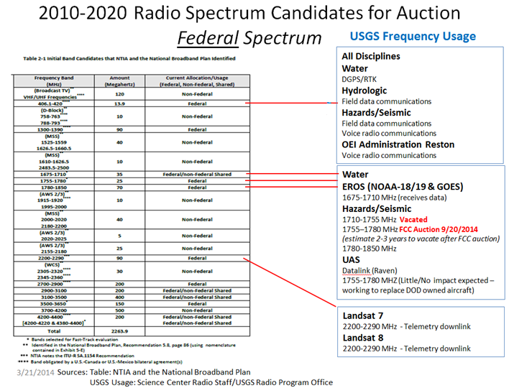
Spectrum At Risk
Frequency Auctions or Sharing
Radio Frequency Spectrum
Sales & Sharing
The
New
Reality
(GOES Downlink)
2700 MHz
3700 MHz
Proposed 1st Spectrum Superhighway
Source: PCAST Report
Notes:
Radio frequency spectrum is a valuable asset. Exclusive authorization may be giving way to more spectrum sharing and privatization.
Spectrum sharing is “New Reality” and “High Priority” according to “NTIA Applaud’s DoD Spectrum Sharing Strategy” report http://www.ntia.doc.gov/blog/2014/ntia-applauds-dod-s-spectrum-strategy-efforts.
Cognitive Radios
Software defined radios
Radio Over IP
Radio in the Cloud
RFA’s issued for 5 year time period
Administration 1%
Biological Resources Division 0%
Geologic Division 92%
National Mapping Division 0%
Water Resources Division 7%

Slide 13
Escalating Urgency and Change
Spectrum sharing verses auctions
  President’s Council of Advisors on Science and Technology (PCAST) *“…the traditional practice of clearing government-held spectrum of Federal users and auctioning it for commercial use is not sustainable.”
  PCAST recommends the President “… require the Secretary of Commerce to identify 1000 MHz of federal spectrum in which to implement shared-use spectrum pilot projects.”
Proposed Update to 500 MHz Goal
* Source: President’s Council of Advisors on Science and Technology (PCAST) report Realizing The Full Potential of Government –Held Spectrum to Spur Economic Growth July 2012

Slide 14
Target Dates for
Sales/Repurpose of Radio Frequency Bands
FCC Auction Set 9/20/14
USGS to vacate by 2017
*May meeting with NOAA
To discuss impacts of repurpose (GOES)
1755 – 1780 MHz
Auction Complete
USGS Vacated Spectrum
No Estimates on
Auctions, sharing or repurpose
FCC band repurpose - possibly 2/15*
406.1 – 420 MHz
1780 – 1850 MHz
1695 – 1710 MHz
1675 – 1710 MHz
2010
2011
2012
2013
2014
2015
2016
2017
2018
2019
2020
Notes:
Identification of 15 Megahertz of Spectrum Between 1675 and 1710 MHz for Reallocation from Federal Use to Non-Federal use pursuant to section 6401(a) of the Middle Class Tax Relief and Job Creation Act of 2012 Report to the President.
Page 1:
This recommendation reaffirms NTIA’s January 2011 conclusion that he FCC should repurpose the 1695-1710 MHz band for wireless broadband use on a shared basis, as NTIA identified in its Fast Track Report.

